Slide 1
CellProfiler
June 14, 2024

Slide 2
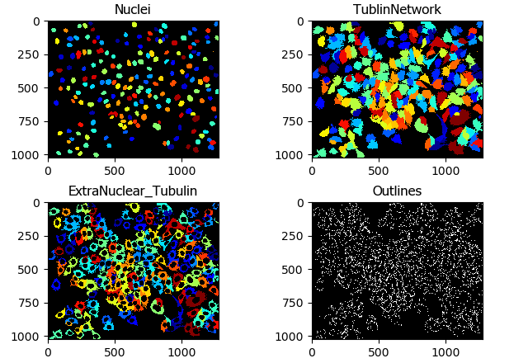
Overview
CellProfiler Operates on Objects
Primary objects are easily segmentable objects we start with
Secondary objects grow from Primary objects
Tertiary objects are the subtraction of primary objects from secondary objects
Objects are masks over any channel
Almost all measurements are done on objects

Slide 3
Usage tips
The easiest way to use CellProfiler is in GUI form, with all your images separated.
It is harder to work with image stacks, or hyperstacks.
Separate z-stacks into image sequences
Separate time-series out as well.
CellProfiler isn’t easy to use in 4D.

Slide 4
Usage tips
The easiest way to use CellProfiler is in GUI form, with all your images separated.
It is harder to work with image stacks, or hyperstacks.
Separate z-stacks into image sequences
Separate time-series out as well.
CellProfiler isn’t easy to use in 4D.

Slide 5
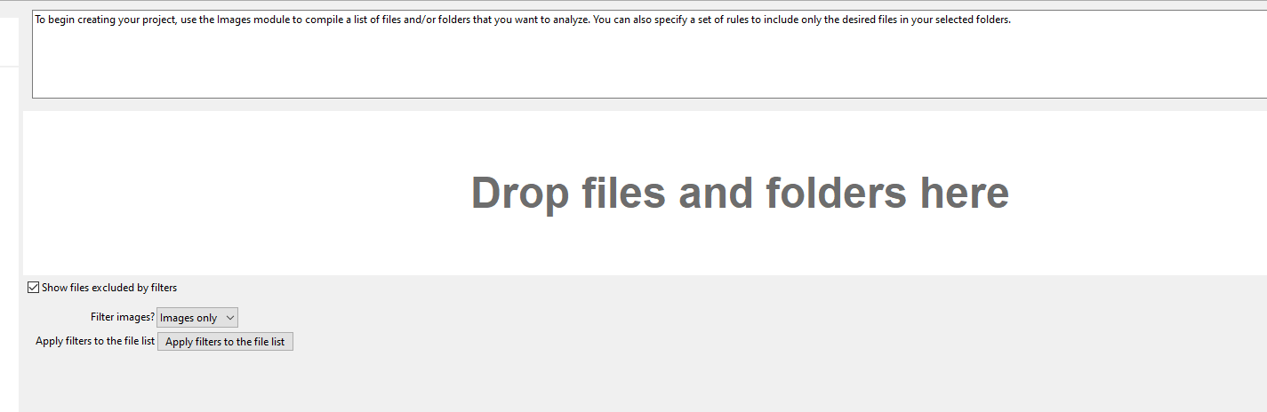
Loading Images
Drop files into the dialog box here

Slide 6
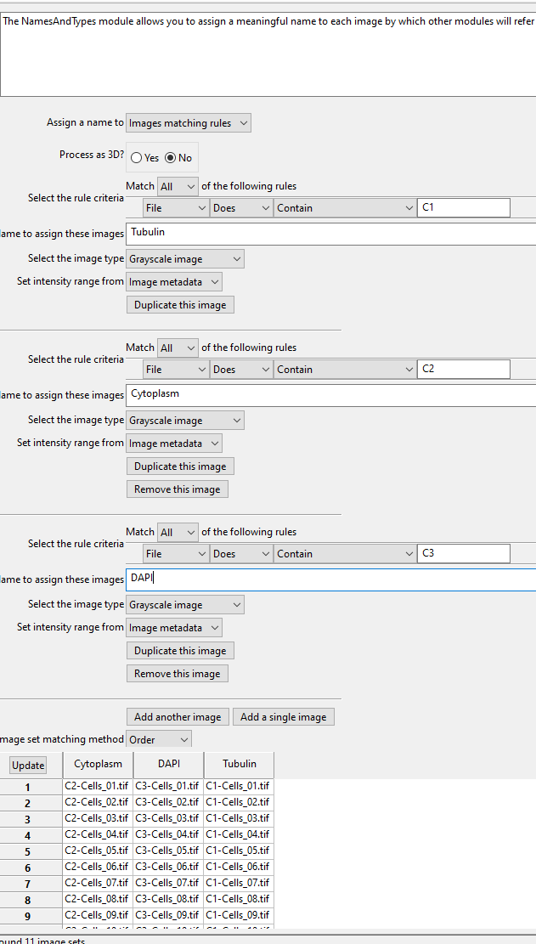
Image Naming
Use rules to differentiate between images
Make sure that each channel has a unique identifier
Usually use the rules ‘Does’ or ‘Does not’ contain an expression. Avoid regular expressions.
Click update and make sure that everything is lined up properly
Numbering goes :
1,10,11,12,….19,2,20,21…….29,3,30…
Always number files 01,02, 03….10,11. etc.
If you will have more than a hundred images
001, 002, 003, ….010….099, 100;

Slide 7
Task 1
Start up CellProfiler
Drag files from Improper_Broad_Cells/Bad_Wrong_int_split into the files box.
Input the images into CellProfiler and create rules to differentiate the images
C1 = Tubulin, C2 = Cytoplasm, C3 = DAPI
Click update…what happens?
Lots of mistakes can be made.
Doubling (IM_01, IM_01a, IM_01_good)
Mixed channels (sometimes, GFP is channel 1, sometimes channel 2)
Bad integers, IM_1, IM)2….IM_10

Slide 8
Task 2
Clear the old images out of CellProfiler file loading module
In Broad Cells folder, open up the “path\to\CellProfiler_Course_Student_Files\Broad_Cells\images” images and use split channels macro from FIJI to split the channels and save in a new folder
Input the new output images into CellProfiler and use your previously created rules to differentiate the images, and click update

Slide 9
Objects
CellProfiler is a powerful segmentation tool. The result of segmentation are objects, which are the backbone of all subsequent processing.
Objects can be extended to find secondary or tertiary objects
Objects can be measured over multiple channels (i.e. use a nuclear object as a mask to measure the signal of another channel inside nuclei).
Objects can be merged, split, eroded, filtered by measurements
Objects can be tracked

Slide 10
Primary Objects
Primary objects are those that are found from an image without any additional information.
Easily detectable objects, as opposed to confluent cells.
Can be found by image analysis techniques in CellProfiler
Thresholding, watershed, etc.
Can be imported from outside image segmentation
StarDist, Cellpose
IdentifyPrimaryObjects identifies biological objects of interest. It requires grayscale images containing bright objects on a dark background. Incoming images must be 2D (including 2D slices of 3D images); please use the Watershed module for identification of objects in 3D.

Slide 11
Primary Objects
Primary objects are those that are found from an image without any additional information.
Easily detectable objects, as opposed to confluent cells.
Can be found by image analysis techniques in CellProfiler
Thresholding, watershed, etc.
Can be imported from outside image segmentation
StarDist, Cellpose
IdentifyPrimaryObjects identifies biological objects of interest. It requires grayscale images containing bright objects on a dark background. Incoming images must be 2D (including 2D slices of 3D images); please use the Watershed module for identification of objects in 3D.

Slide 12
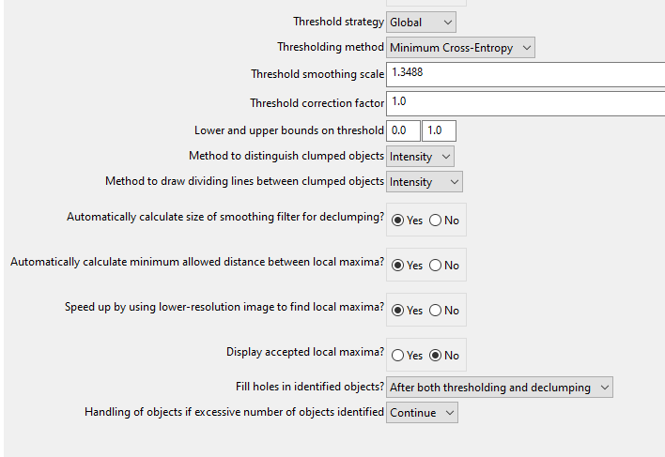
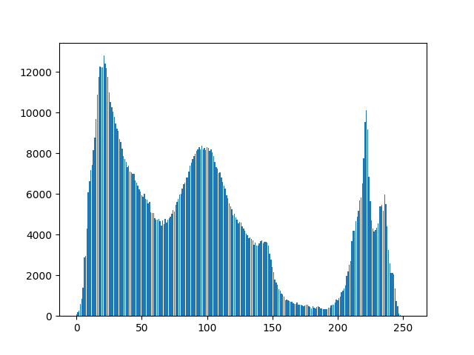
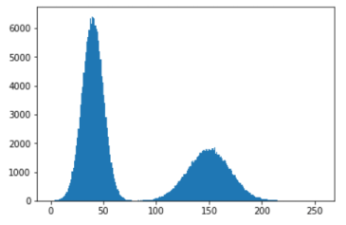
Thresholding
Global is more useful. If doing adaptive, then do illumination correction
Play with the thresholding method. The Otsu method lets you do a three class thresholding.
Declumping by intensity is useful if there is good demarcation between objects
Declumping by shape is useful if there is curvature between the objects

Slide 13
Task 3
Find Primary objects in the DAPI channel
Configure the thresholding and size so that you find whole nuclei
To test a pipeline, click ‘Start Test Mode’ and then step through it.
Clicking on the eyeball suppresses screen output from a module
Clicking on a check box turns on/off module
Clicking on the pause button puts a break point in a pipeline, and you can then click ‘run’ to go as far as the breakpoint
Changing a module, then re-clicking the green arrow will refresh the changes

Slide 14
Secondary Objects
Secondary objects use a primary object for reference in detection, i.e. a nuclei to start, and then propogate out to find cell boundary in cytoplasm
Tertiary objects are just secondary objects with the primary object removed (i.e. cytoplasm without the nuclei)

Slide 15
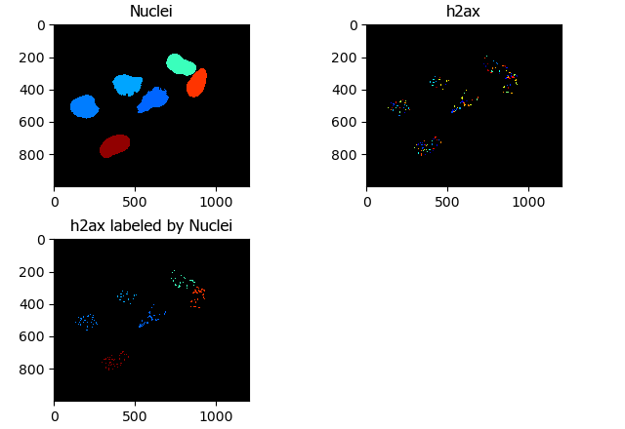
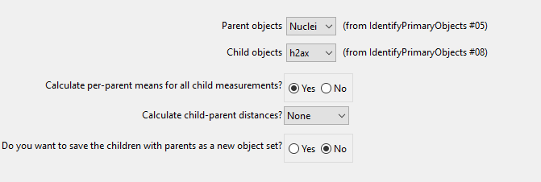
Relating Objects
Relating objects gives a child-parent relationship between two sets of objects.
This would be for something akin to RNAScope, where you would want to count the number or intensity of labelled RNA inside a nucleus

Slide 16
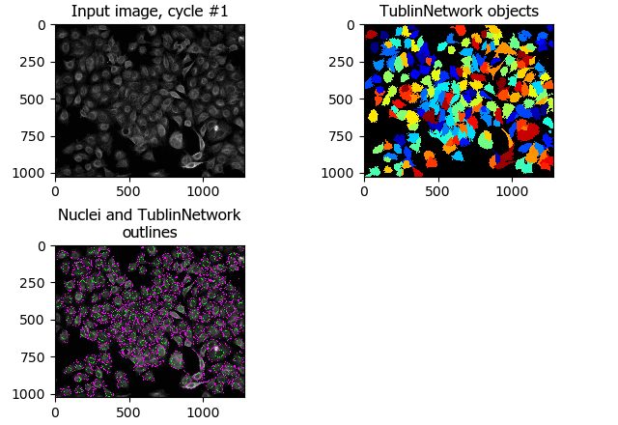
Relating Objects vs Secondary Objects
Secondary objects ‘grow’ from primary objects
Related objects are ‘inside’ other objects.
The two related objects can both be primary objects.
You can’t relate a secondary object set to the primary object set it grew from

Slide 17
Object Measurements
You can measure a variety of parameters of the objects
Intensity
Total
Gradients
Colocalization
Granularity
Texture
Size/Shape properties
Area
Eccentricity
Number of Neighbors
You can plot within CellProfiler, but you can’t save the plots programmatically.

Slide 18
Saving Data
Can export image files and csv files
Can also export databases for CellProfiler Analyst, which is beyond the scope of this class

Slide 19
Task 4
For this task, we’re carrying on with the broad cells
Measure the size of the primary objects (look in the list for something along the lines of ‘MeasureObjectSizeShape’
Save a csv file with the object sizes
Save your pipeline

Slide 20
Task 5
Save your current pipeline
Open the pipeline for Example Speckles and load the data
We’re going to explore this together

Slide 21
Coffee Break

Slide 22
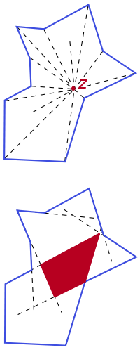
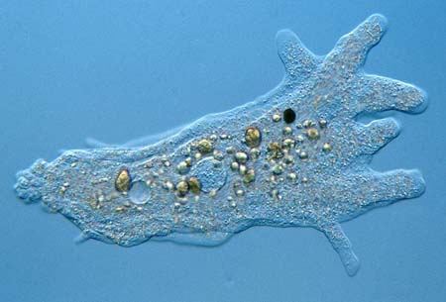
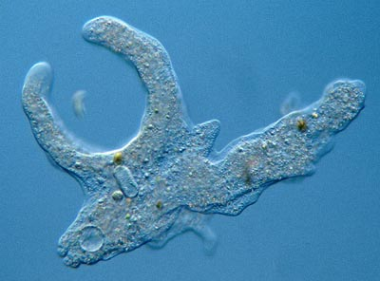
StarDist (or CellPose)
Stardist can only detect objects that are Star-convex: all the points of the perimeter can be reached by rays emanating from a point somewhere in the object.
StarDist is a plugin for FIJI that allows for quick segmentation of star-convex objects (round, nuclear shaped things).
StarDist can’t be run inside CellProfiler, but it’s a great trick to know
Running StarDist on a DAPI channel, and bringing those results in to CellProfiler as a separate image channel allows for easy nuclear segmentation

Slide 23
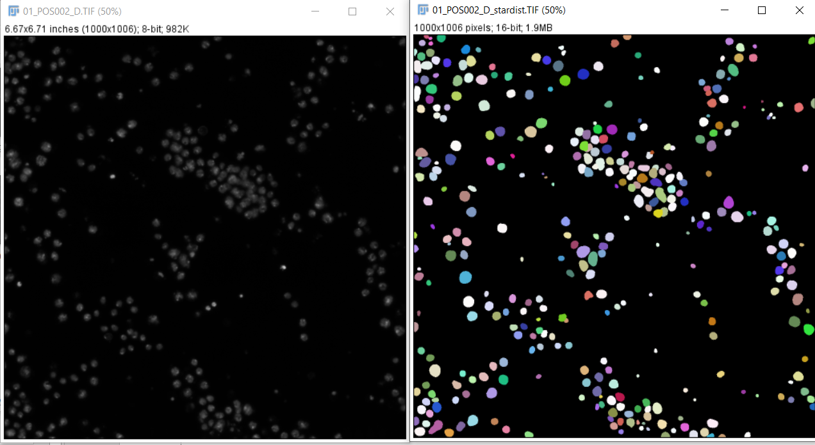
StarDist in FIJI
Need to add the CSBDeep and StarDist libraries
Run stardist on a nuclear image, and save the resulting prediction image as a tiff. The ‘pixel intensity’ of each nuclei is the nuclear ID label

Slide 24
Using StarDist
We can creat StarDist images using the FIJI plugin, or the FIJI macro we have: ‘stardist_process_folder.ijm’
StarDist label images have to be imported into CellProfiler differently:
Use the module ConvertImageToObjects
Convert to Boolean == no
Preserve original labels == yes

Slide 25
Task 6
Use StarDist to try to better differentiate the nuclei in the ExampleHuman project
Load the Example Human Pipeline
\CellProfiler_Course_Student_Files\ExampleHuman\ExampleHuman\
Run the DAPI channel on StarDist in FIJI
Compare nuclear segmentation from the original project with that from stardist labels

Slide 26
Task 7
\CellProfiler_Course_Student_Files\Broad_Cells\Split_Channels
Create the naming rules to find the Tubulin, Cytoplasm, DAPI and StarDist channels
Make an image of the StarDist nuclei overlaid on the DAPI image, and save
You may want to play with the opacity
Measure the area of the StarDist nuclei, and display their size on a DAPI image overlay, in green
Display the outlines of the extranuclear tubulin on the DAPI image, in red
Measure the intensity of the tubulin both in and out of the nuclei.

Slide 27
Further Study
I’ve included a 3D FISH analysis pipeline, and a 3D cell segmentation pipeline.
I’ve included a pipeline for illumination correction and a document on it. Illumination correction is often useful, especially on widefield or TIRF images, but needs understanding
You can run CellProfiler command line only, and run it distributed on and HPC cluster. This is very useful, but beyond the scope of this course. If you would like to do it, email me.

Slide 28
Thanks
Todd Fallesen
Camille Charoy
Dan Gunton

